Slide 1
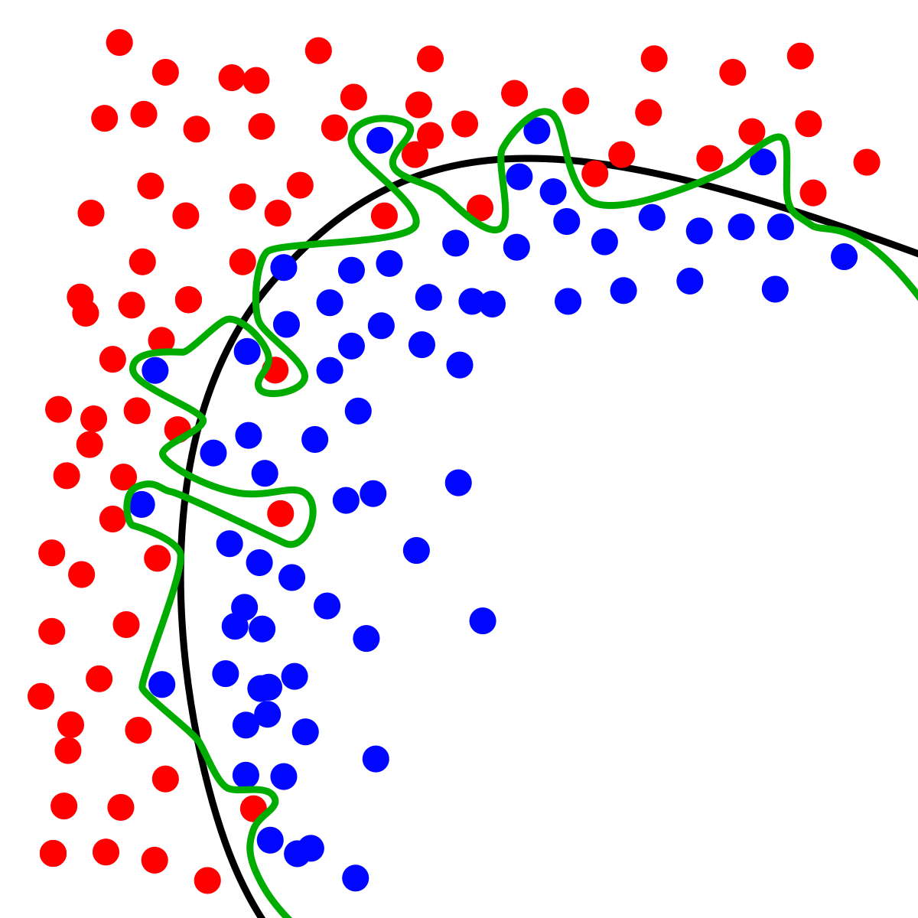
Dynamic Systems Thinking for Psychologists
Michael E. Aristodemou
michael.aristodemou@psychologie.uzh.ch
Lecture 9: Interventions and external shocks

Slide 2
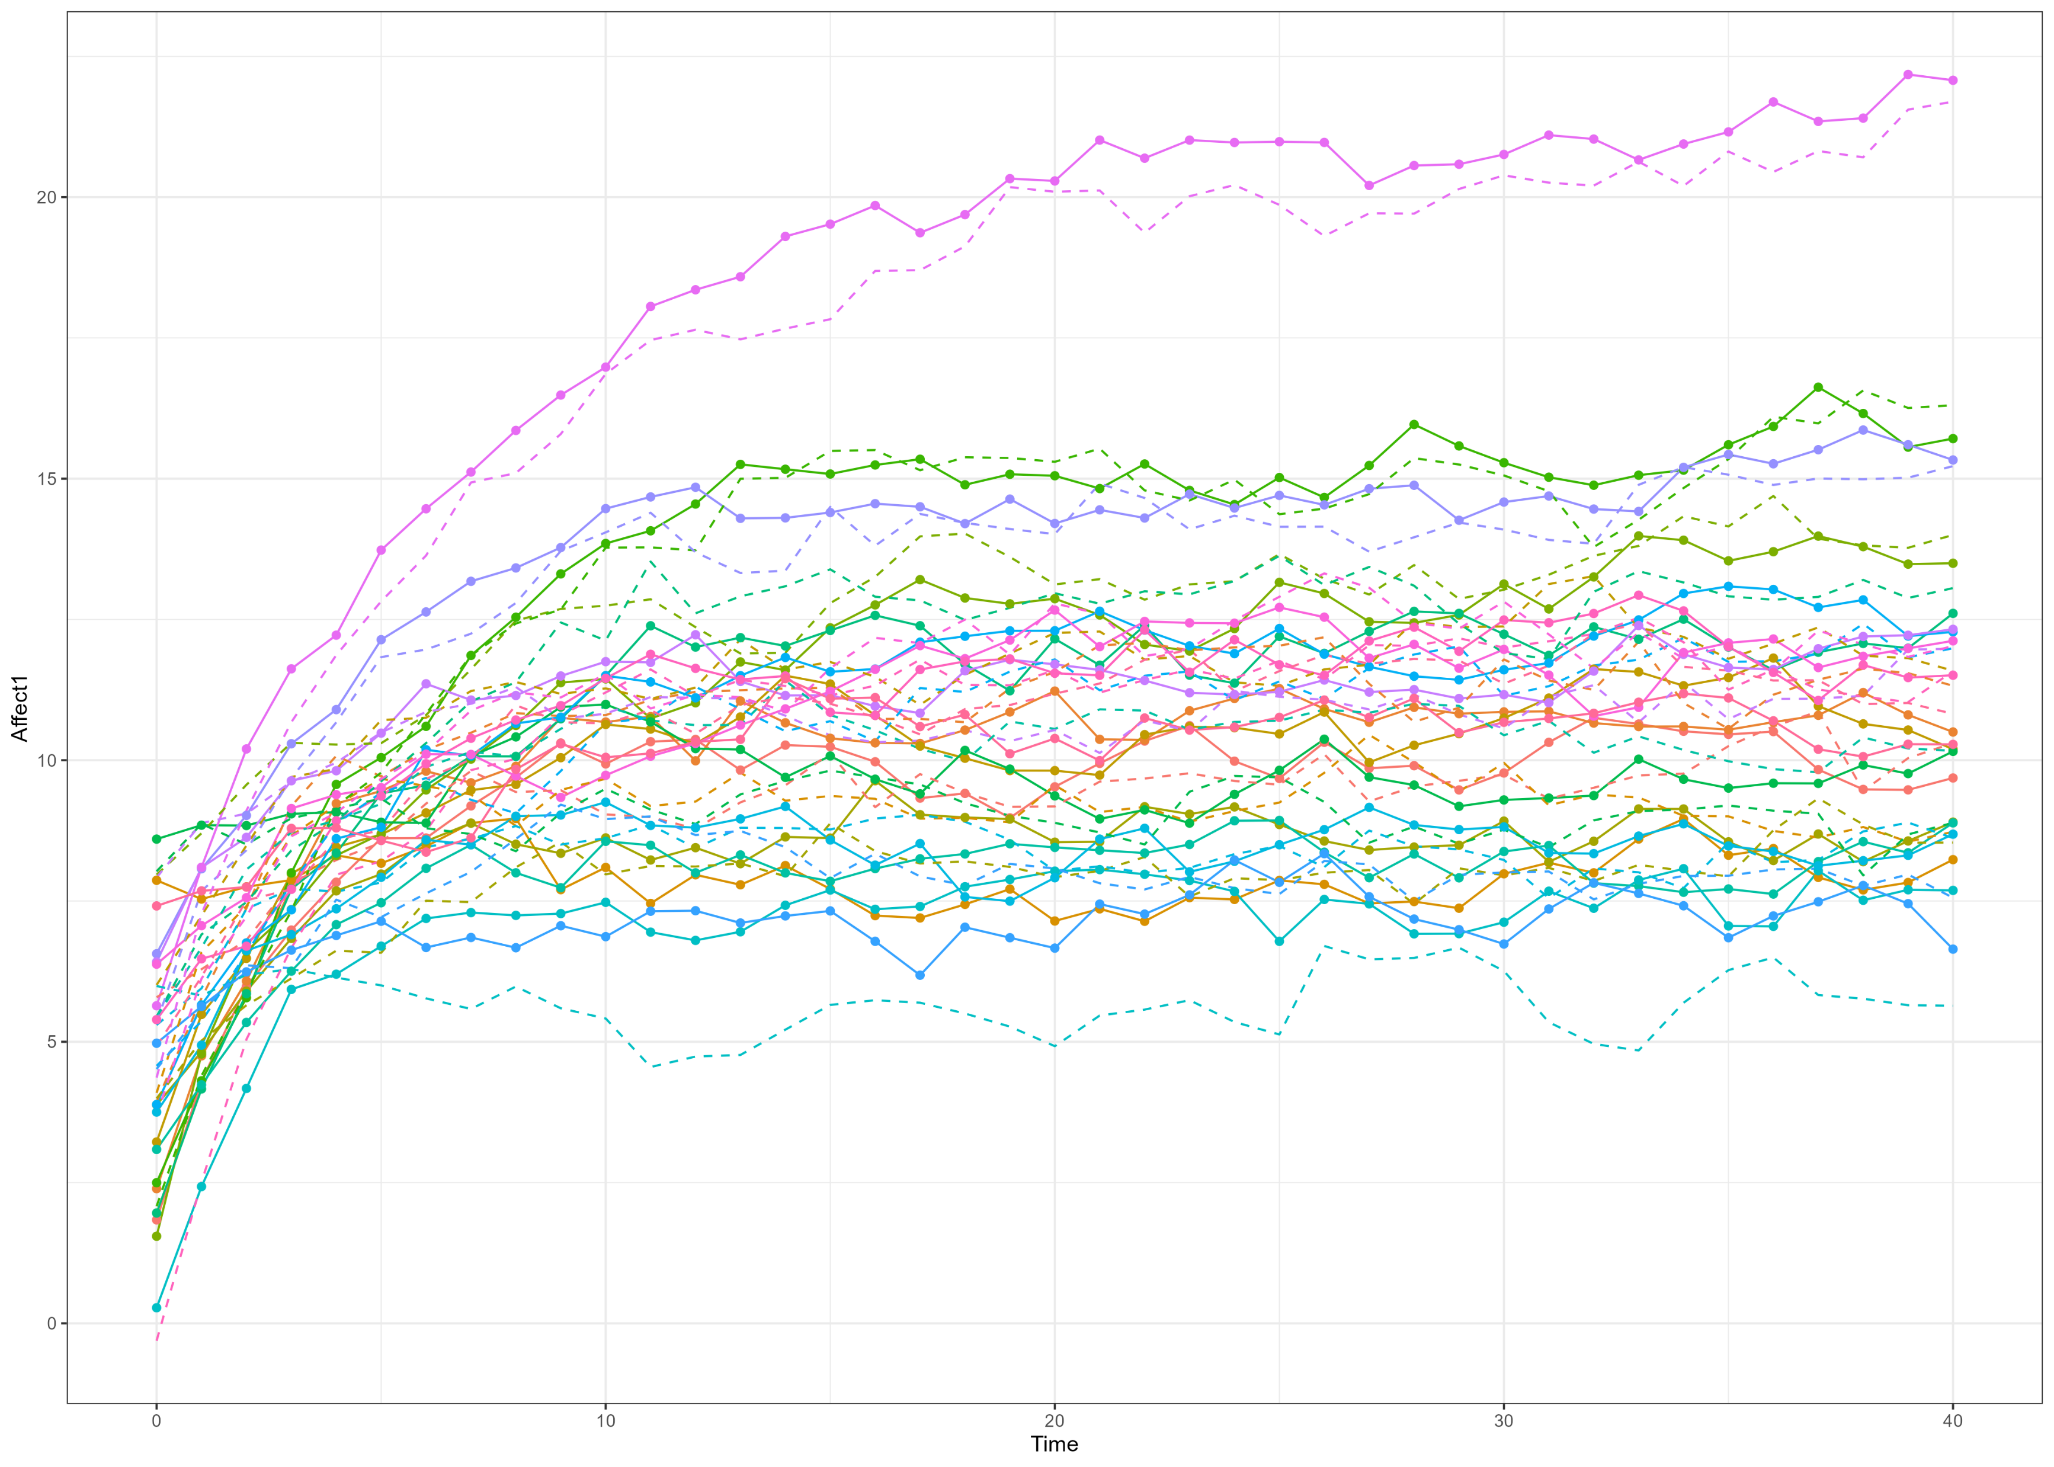

Slide 3
Albert and the Rabbit always affect each other’s mood

Slide 4


How can we change this?
$$dη_{1}=\left(A_{1}η_{1t}+A_{cross_{12}}η_{2t}+B_{1}\right)dt+G_{11}dW_{1}t$$
$$dη_{2}=\left(A_{2}η_{2t}+A_{cross_{12}}η_{1t}+ B_{2}\right)dt+G_{22}dW_{2}t$$

Slide 5
Moderate coupling by presence
$$dη_{1}=\left(A_{1}η_{1t}+A_{cross_{12}}η_{2t}∗Comm_{t}+B_{1}\right)dt+G_{11}dW_{1}t$$
$$dη_{2}=\left(A_{2}η_{2t}+A_{cross_{12}}η_{1t}∗Comm_{t}+ B_{2}\right)dt+G_{22}dW_{2}t$$

Slide 6
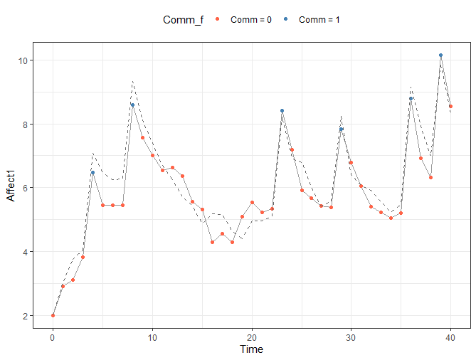
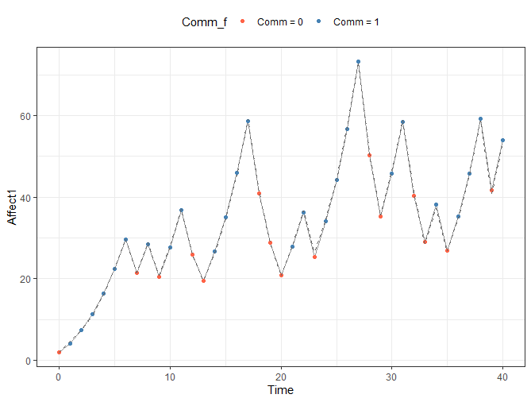

Slide 7
Group exercise
Integrate time-dependent predictors into your own theory
Helpful code under GitHub → Lecture8
Scripts:
Turning coupling on and off: TDPRED_Couple_W8.R
Thresholded state dependence: TDPRED_TAR_W8.R

Slide 8

Shocking a system
When you imagine an external input that affects a process how do you see it?
Mood
Time

Slide 9
Draw the effect of a shock on mood
Mood
Your drawing continues the purple line
Time

Slide 10
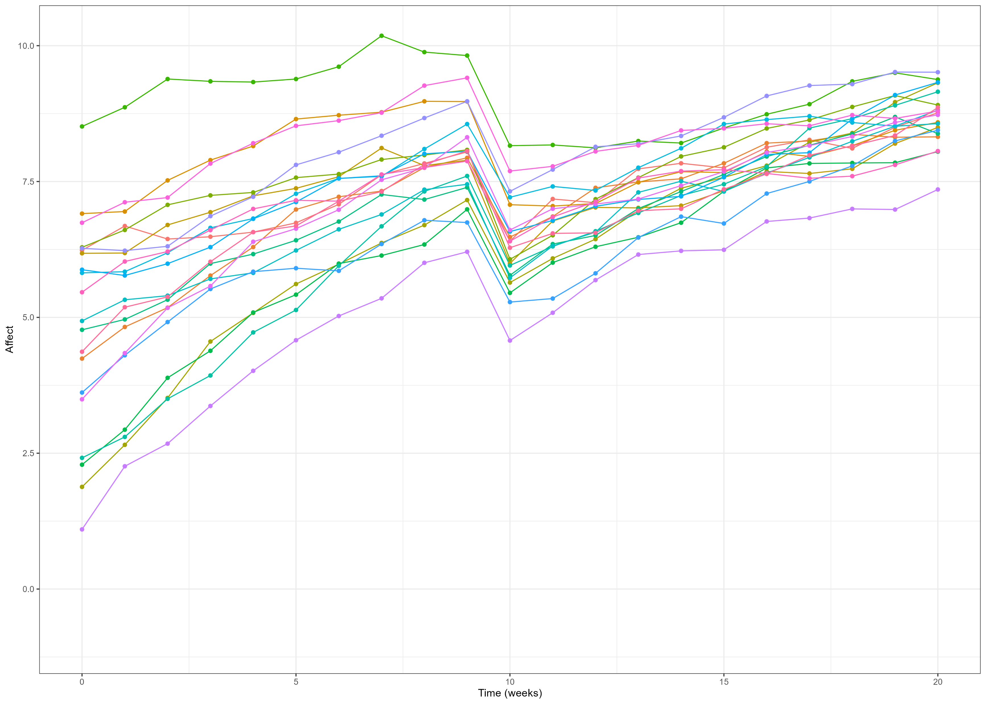
The simplest shock (transient influence)

Slide 11
The simplest shock (transient influence)

Slide 12
The simplest shock (transient influence)
Before/after shock period:
$$dη_{1}=\left(A_{1}η_{1t}+B_{1}\right)dt+GdWt$$
During shock period:
$$dη_{1}=\left(A_{1}η_{1t}+B_{1}+M\right)dt+GdWt$$

Slide 13
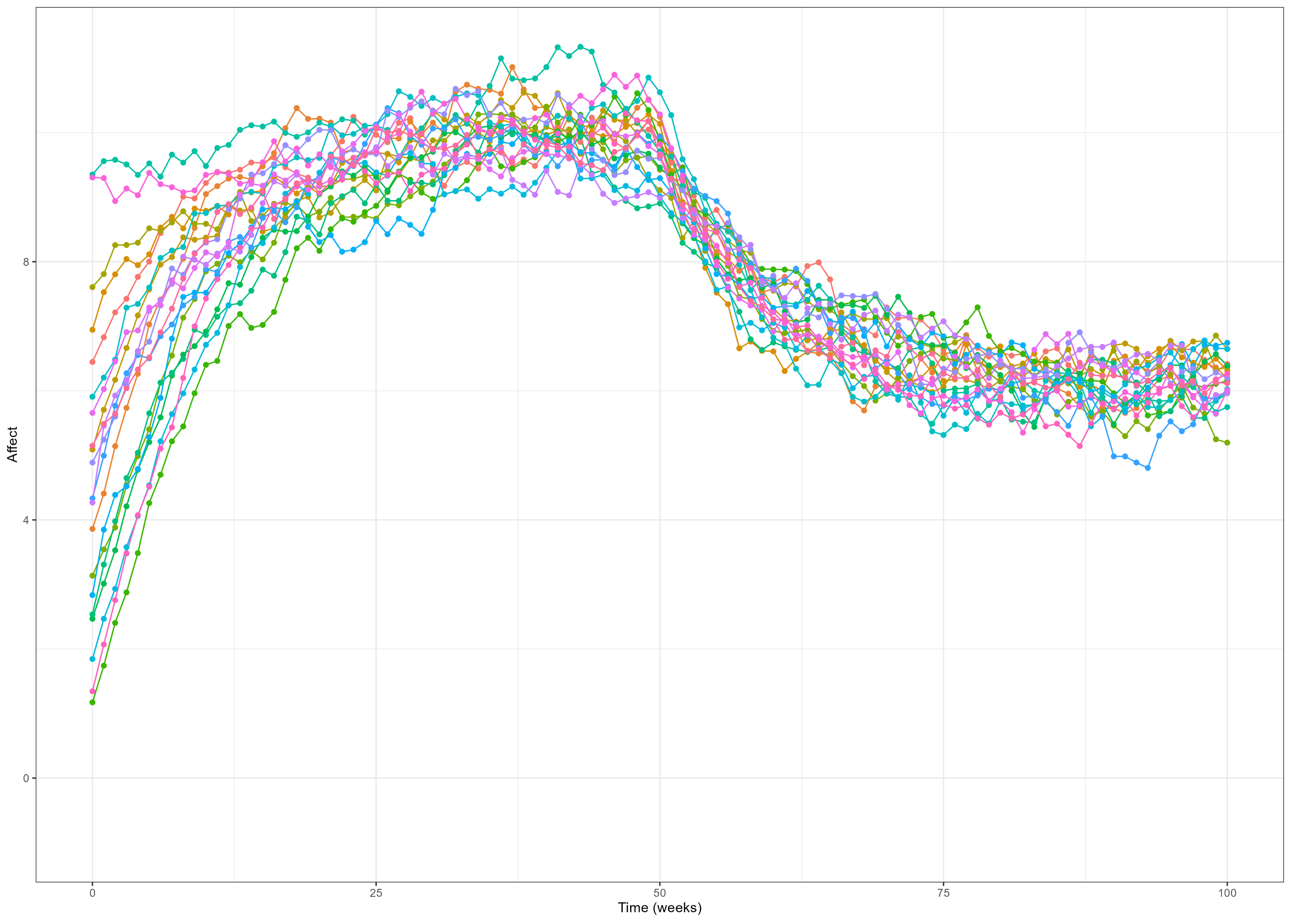
A shock that lasts forever (persistent shock)

Slide 14
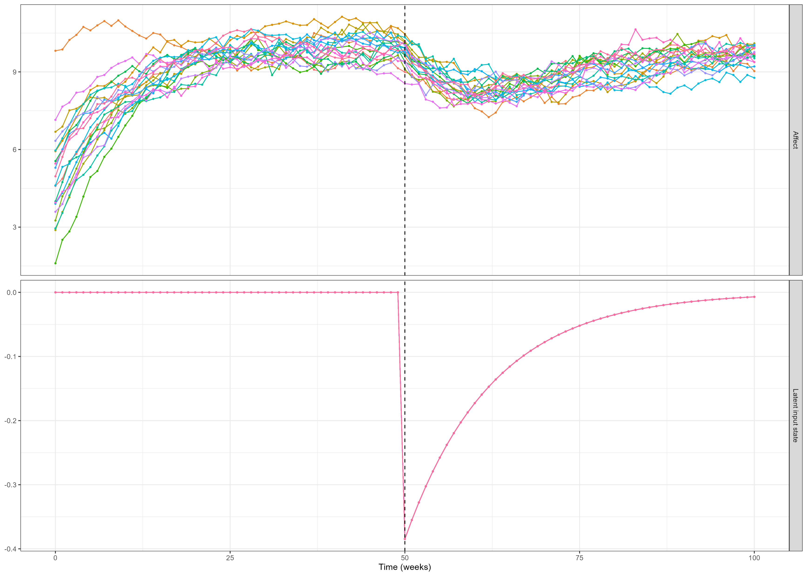
A shock that dissipates

Slide 15
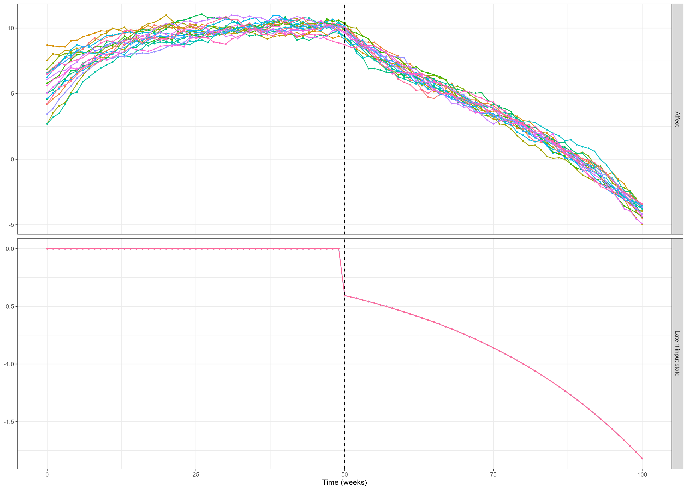
A shock that accumulates

Slide 16
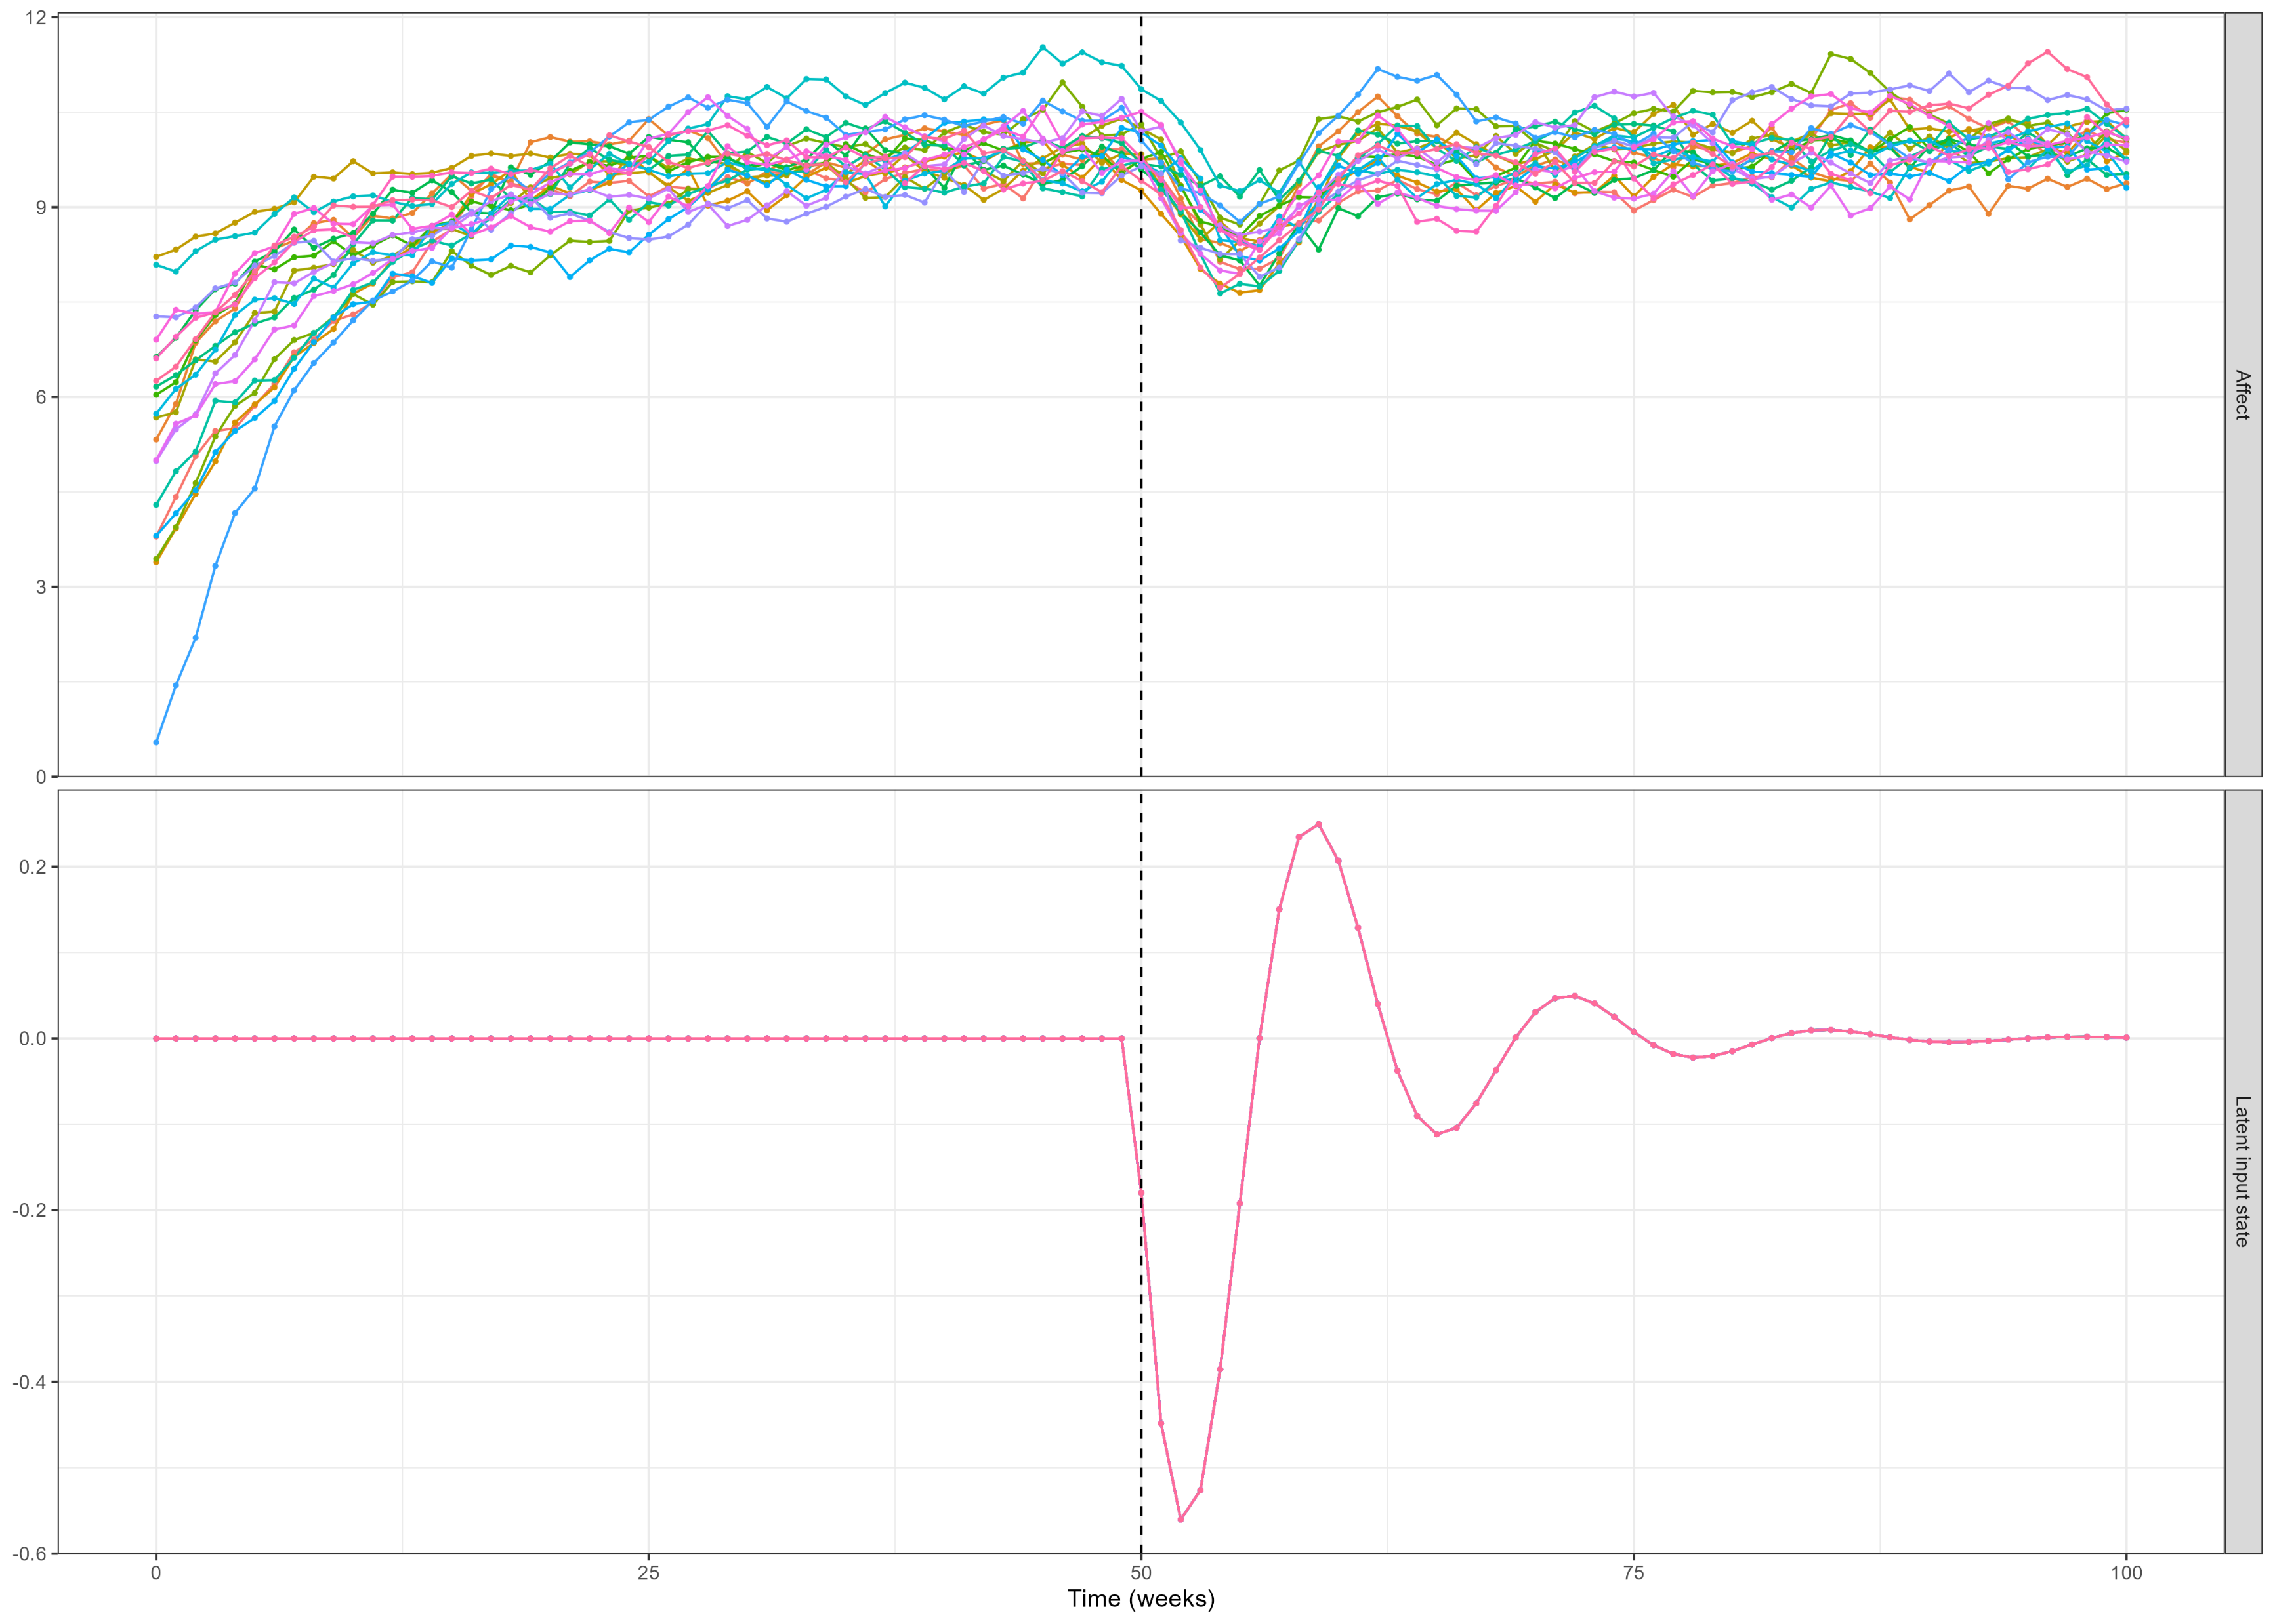
A shock that dissipates in waves

Slide 17
Group exercise
Try to assess how your system reacts to a shock
Draw the trajectory of the shock/write a story about it
Try to code and visualize the shock
Shift the InputTime (timing of shock) see how it change its effect
Helper code GitHub → Lecture9:
Transient shock (example 1): TransientShock_W9.R
Persistent shock (example 2): PersistentShock_W9.R
Dissipative shock (example 3): PersistentShock_W9.R (change AM < 0)
Cumulative shock (example 4): PersistentShock_W9.R (change AM > 0)
Dampening oscillator (example 5): DampedOsc_Shock_W9.R

Slide 18
Thank you for listening ☺

